Slide 1
Introduction to Management Part II- Manager and Managerial Roles

Slide 2

Who is a Manager?

Slide 3
Manager/s
The people responsible for directing the efforts aimed at helping organisations achieve their goals.
(Stoner, Freeman and Gilbert, 2008)
Someone who coordinates and oversees the work of other people so that organisational goals can be accomplished.
(Robbins and Coulter, 2012)
Someone whose primary responsibility is to carry out the management process.
(Griffin,2012)
In general we can define a manager as someone who performs management functions in an organisation.

Slide 4
Types of Managers
The Managerial Levels
First line managers
Middle managers
Top managers
Scope of the Activities
Functional managers
General managers
Responsibility of the Activities
Line managers
Staff managers

Slide 5
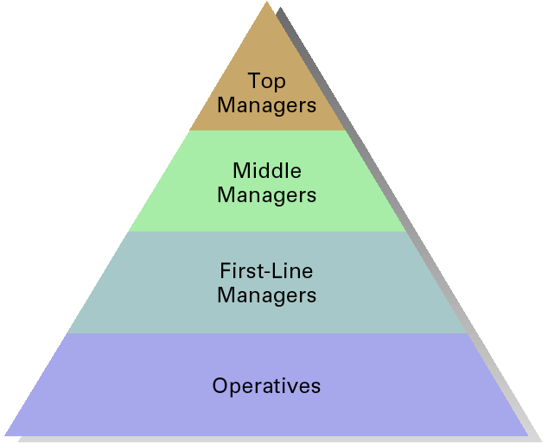
Classification of Managers by the Managerial Level

Slide 6
Types of Managers based on Managerial Level in an Organisation
First-line managers
Supervisors responsible for directing the day-to-day activities of operative employees
Middle managers
Individuals at levels of management between the first-line manager and top management
Top managers
Individuals who are responsible for making decisions about the direction of the organisation and establishing policies that affect all organisational members

Slide 7
Types of Managers based on the Scope of Activities in an Organisation
General
Manager
Production Manager
Marketing
Manager
Finance
Manager
HR
Manager

Slide 8
Functional and General Managers
Functional manager
A manager who is responsible for one business function in an organisation.
General manager
The individual responsible for all the business functions in an organisation.

Slide 9
Line and Staff Managers
Line managers are responsible for work activities that directly affect organisation’s outputs and objectives.
Staff managers use technical expertise to advise and support the efforts of the line managers and workers .

Slide 10
Managerial Skills
Managerial skills is generally a pre-requisite for management success. (Certo and Certo 2009)
What type of skills do managers need?
Robert L. Katz proposed that managers need three critical skills in managing an organization.
Conceptual skills
Human skills
Technical skills

Slide 11
Managerial Skills
Conceptual skills: the ability to analyze and diagnose a situation and find the cause and effect.
Human skills: the ability to work well with other people individually and in a group.
Technical skills: the job-specific knowledge required to perform a task. Common examples include marketing, accounting, and manufacturing.
All three skills are enhanced through formal training, reading, and practice.

Slide 12
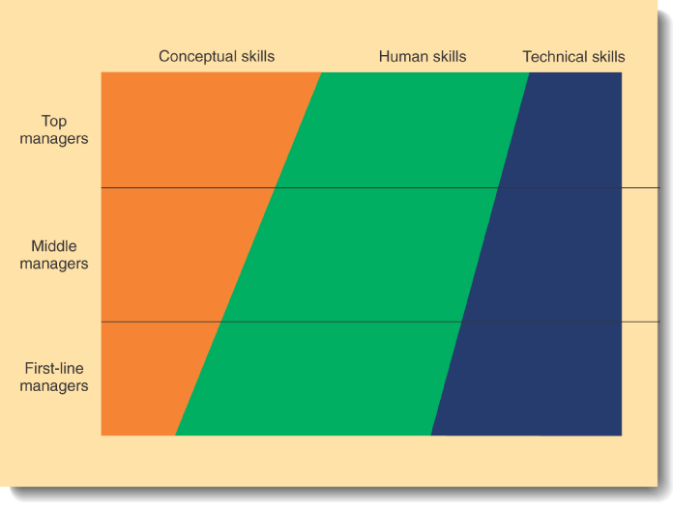
Relative Skills Needed for Effective Performance at Different Levels of Management
(Jones and George, 2008)

Slide 13
What Managers Do? Henry Mintzberg’s Managerial Roles
Managerial roles refers to specific actions or behaviours expected of and exhibited by a manager.
(Robbins and Coulter, 2011)

Slide 14
Key Managerial Roles (Mintzberg)
Key Management Roles
Interpersonal Roles
Informational Roles
Decisional Roles
Figurehead
Leader
Liaison
Monitor
Disseminator
Spokesperson
Entrepreneur (Innovator)
Disturbance Handler
Resource Allocator
Negotiator

Slide 15
Interpersonal Roles
Roles managers assume to coordinate and interact with employees and provide direction to the organisation.
Figurehead role: Perform ceremonial and symbolic duties such as greeting visitors, signing legal documents.
Leader role: Direct and motivate subordinates, train counsel and communicate with subordinates.
Liaison role: Maintain information links and coordinate people inside and outside the organisation to help achieve goals.

Slide 16
Informational Roles
Associated with the activities needed to obtain and transmit information for management of the organisation.
Monitor role: Seek and receive information from both the internal and external environment.
Disseminator role: Forward information about the changes taking place in the external and internal environment to the organisation members.
Spokesperson role: Transmit information through speeches and reports to outsiders of the organisation.

Slide 17
Decisional Roles
Associated with the methods managers use to plan strategy and utilize resources to achieve goals.
Entrepreneur role: decide and initiate projects; identify new ideas, delegate idea responsibility to others.
Disturbance handler role: assume responsibility for handling an unexpected event or crisis.
Resource allocator role: assign resources between functions and divisions, set budgets of lower managers.
Negotiator role: seeks to negotiate solutions between other managers, unions, customers, or shareholders.

Slide 18
Requirements to be an Effective and Efficient Manager
Knowledge (know what, know how)
Skills (general and specific)
Positive Attitudes (on work, people, environment and on self)

Slide 19
Challenges faced by Modern-day Managers
Managing global competition.
Facing the competition through superior efficiency, quality, innovation, and responsiveness.
Increasing performance while being an ethical manager.
Balancing the interests of different stakeholders.
Managing a diversified workforce.
Adopting new technologies.
Managing creativity, innovation and continuous change.

